Slide 1

Branch - CSE Python Programming
Lecture – 19 Dictionary – Part 2
By
Dr. Smita Tiwari
Assistant Professor
Department of Computer Science and Engineering
School of Engineering & Technology

Slide 2
Aliasing and Copying
Since, dictionaries are mutable, you need to be aware of aliasing.
Whenever two variables refer to the same object, changes to one affect the other.
If you want to modify a dictionary and keep a copy of the original, use the copy method.
For example, opposites is a dictionary that contains pairs of opposites. (next slide)

Slide 3
Aliasing and Copying
Since, dictionaries are mutable, you need to be aware of aliasing.
Whenever two variables refer to the same object, changes to one affect the other.
If you want to modify a dictionary and keep a copy of the original, use the copy method.
For example, opposites is a dictionary that contains pairs of opposites. (next slide)

Slide 4
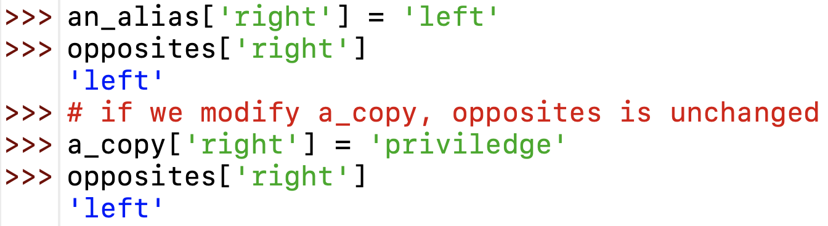
Aliasing and Copying
an_alias and opposites refer to the same object; a_copy refers to a fresh copy of the same dictionary.
If we modify alias, opposites is also changed.

Slide 5
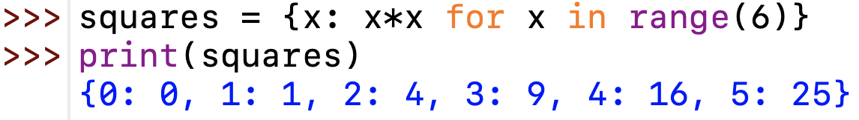
Python Dictionary Comprehension
Dictionary comprehension is an elegant and concise way to create a new dictionary from an iterable in Python.
Dictionary comprehension consists of an expression pair (key:value) followed by a for statement inside curly braces {}.

Slide 6
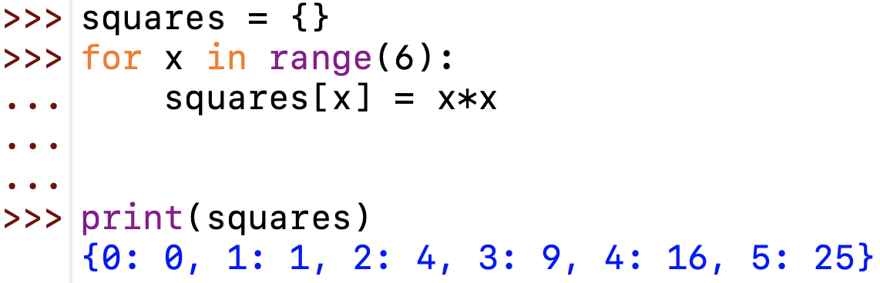
Python Dictionary Comprehension
This code is equivalent to:

Slide 7
Python Dictionary Comprehension
A dictionary comprehension can optionally contain more for or if statements.
An optional if statement can filter out items to form the new dictionary.

Slide 8
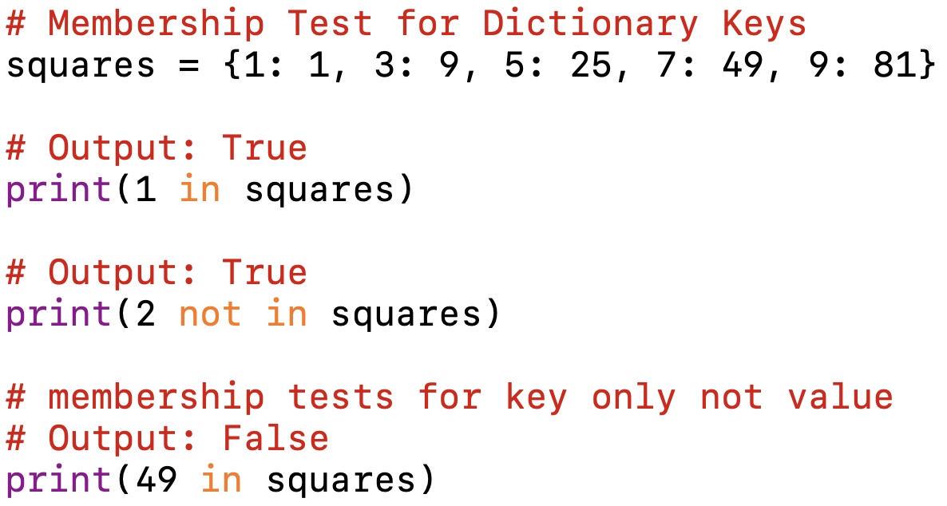
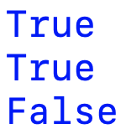
Dictionary Membership Test
We can test if a key is in a dictionary or not using the keyword in.
Notice that the membership test is only for the keys and not for the values.
Output:

Slide 9
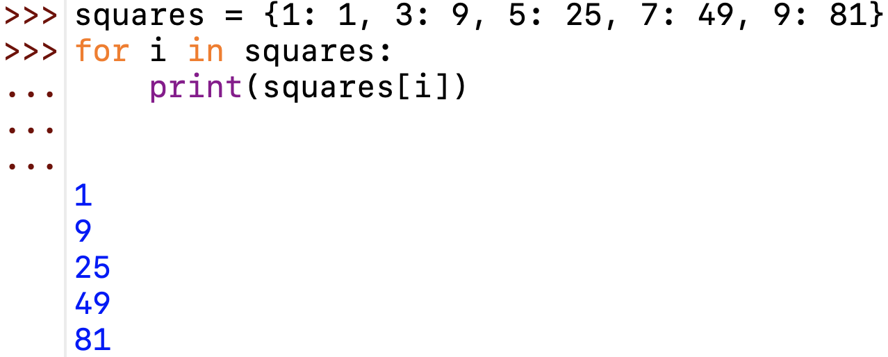
Iterating Through a Dictionary
We can iterate through each key in a dictionary using a for loop.

Slide 10
Dictionary Built-in Functions
Function | Description
all() | Return True if all keys of the dictionary are True (or if the dictionary is empty)
any() | Return True if any key of the dictionary is True. If the dictionary is empty, return False.
len() | Return the length (the no. of items) in the dictionary.
sorted() | Return a new sorted list of keys in the dictionary

Slide 11
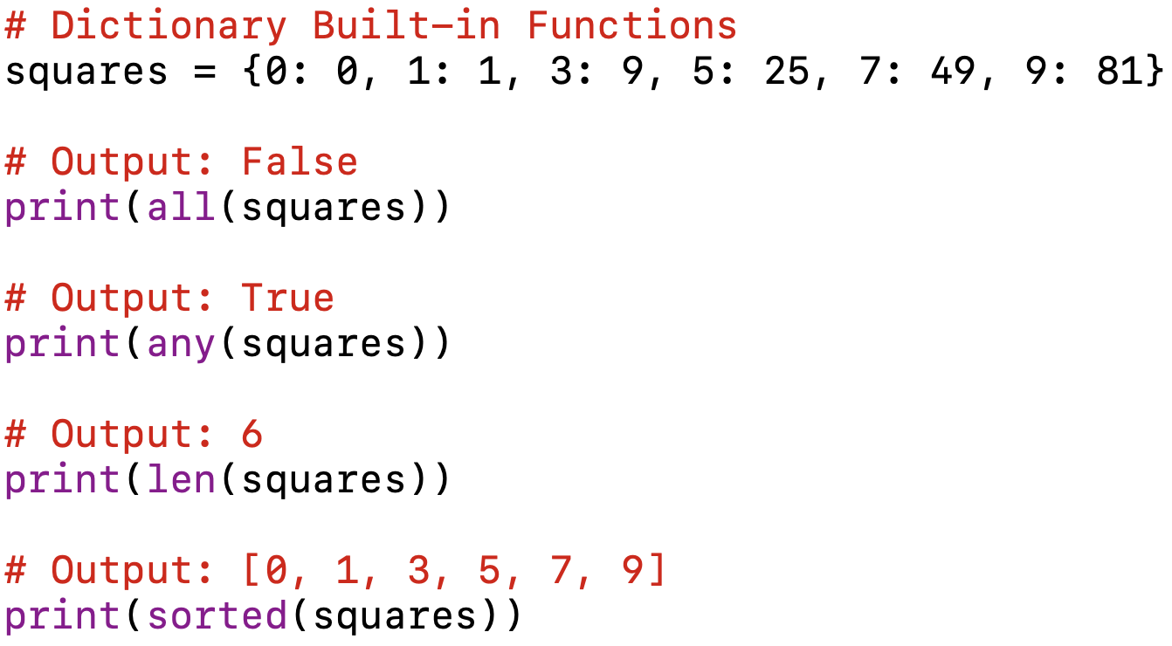
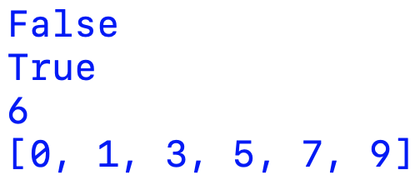
Dictionary Built-in Functions
Output:

Slide 12
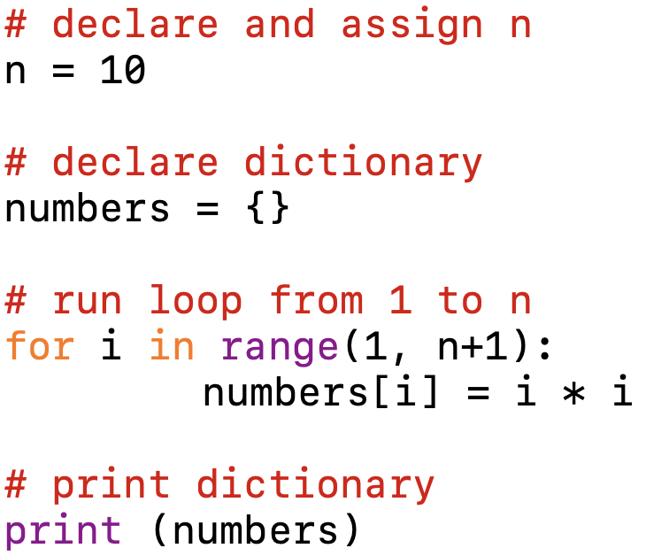
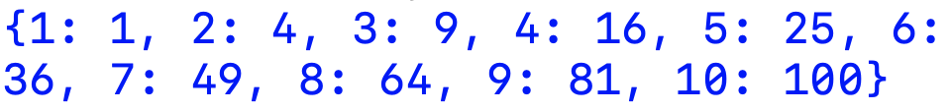
Example #1
Generate dictionary of numbers and their squares (i, i*i) from 1 to N
Output:

Slide 13
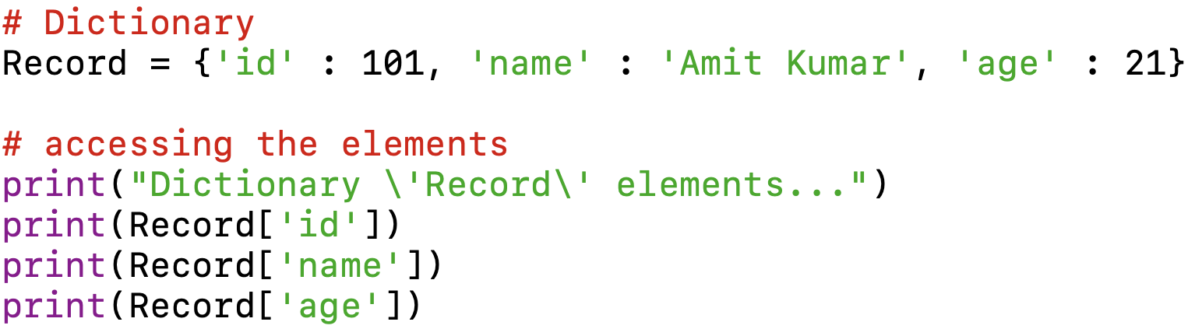
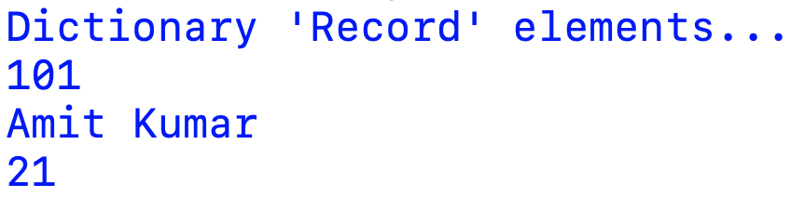
Example #2
Python program for accessing elements from a dictionary
Output:

Slide 14
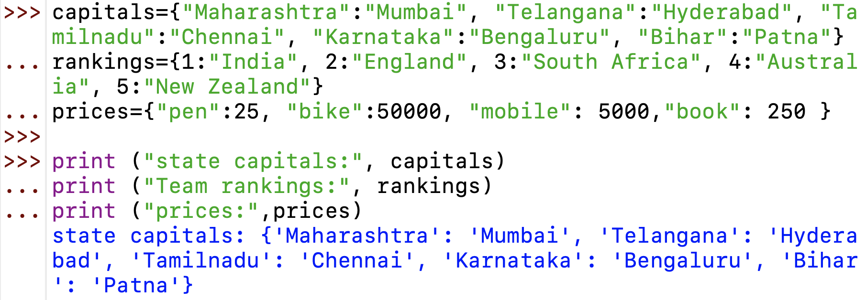
Example #3

Slide 15
THANK YOU

